Slide 1
Optimizing Bank Marketing Strategies through Predictive Analytics and Customer Segmentation (Results, Limitations and Conclusion)
Presentation By:
Venkata Ram Pranith Garlapati
PACE UNIVERSITY
vg28691n@pace.edu
https://github.com/Pranithgarlapati17/CS668

Slide 2
Overview of the project
Overview
Key Objectives
The presentation summarizes an objective and thorough procedure for designing the predictive analytics and customer segmentation approaches for bank marketing strategies.
Emphasis placed on machine learning predictive analytics to developing customer conversion probabilities to improve campaign targeting and marketing efficiency.
Find out the most important features of customer conversion rates during bank telemarketing campaigns.
Utilization of advanced machine learning models like Random Forest, XGBoost for the prediction of customers subscribing to term deposits.
Make effective customer segmentation to allow optimized conversion rates at lower marketing costs

Slide 3
Approach and Methodologies
Exploratory Data Analysis (EDA):
Feature Engineering:
Model Selection and Evaluation:
An exploratory data analysis was conducted to explore customer demographics, account balance distributions, and outcomes from campaigns.
Visualizations were done exploring the relationship between the features such as age, occupation, and subscription rates that figured out important influencing factors.
Feature selection techniques selected useful relevant variables, specifically age, occupation, and previous campaign outcomes.
Created interaction features like job type and education level to augment model performance.
Applied machine learning methods such as logistic regression, random forest, XGBoost, and gradient boosting.
Cross-validation confirmed model generalization without suffering from overfitting.
Evaluation metrics consisted of precision, recall, F1-score, accuracy, and ROC-AUC; and SHAP values were used to interpret the model outputs and derive business values.

Slide 4
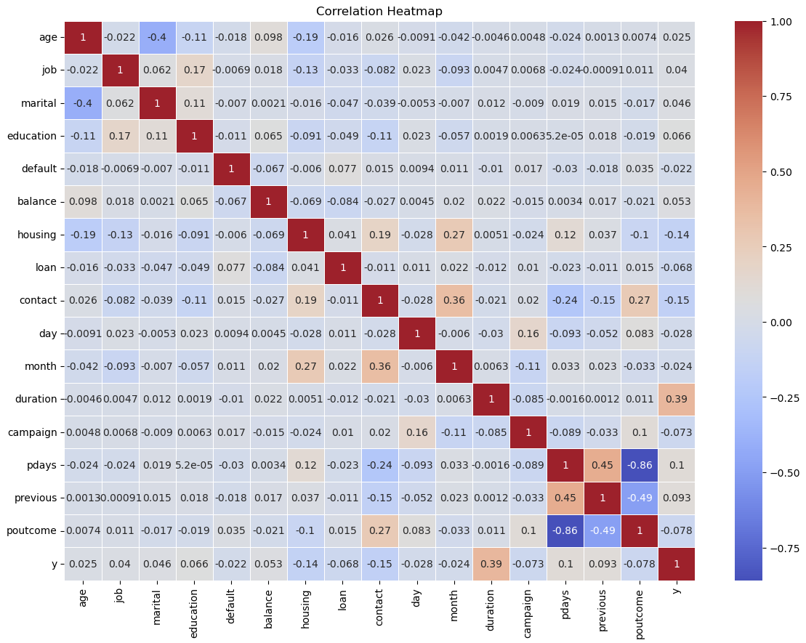
Results: Correlation Heatmap and Feature Selection
Correlation Heatmap:
Highlights relationships between key features and customer subscription.
Significant features include duration, contact type, and housing loan status.
Key Influential Features:
Features such as duration, contact type, pdays, and previous campaign outcomes were identified as most impactful for predicting customer conversion.
Conclusion:
These key features are crucial for building predictive models and optimizing marketing campaigns.

Slide 5
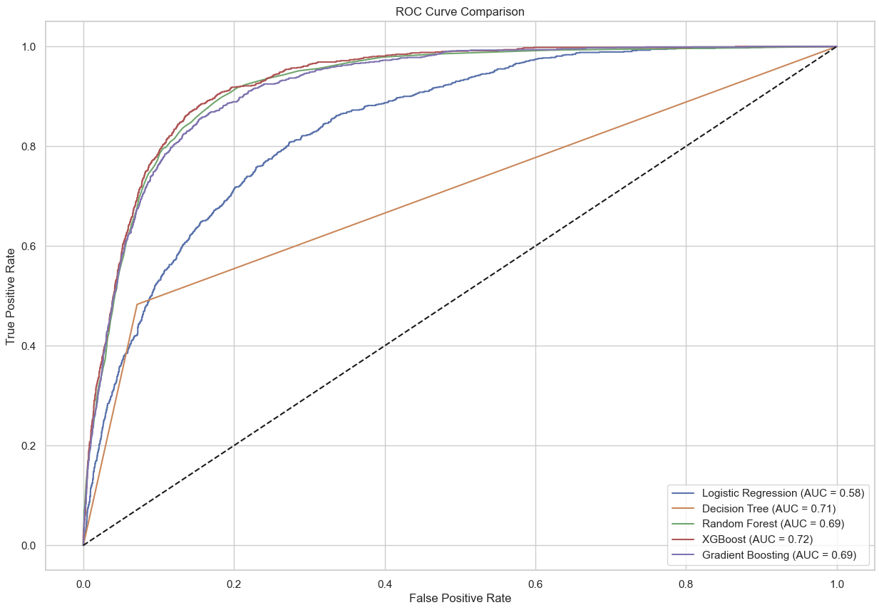
Key Results from the Predictive Models
The ROC curve demonstrates the performance of several models:
XGBoost achieved the highest Area Under Curve (AUC) score of 0.72, indicating the best discriminative power.
Random Forest and Gradient Boosting both achieved an AUC of 0.69, showing moderate performance.
Decision Tree had an AUC of 0.71, while Logistic Regression lagged with an AUC of 0.58.
The comparison shows that ensemble models generally perform better in distinguishing between positive and negative outcomes.

Slide 6
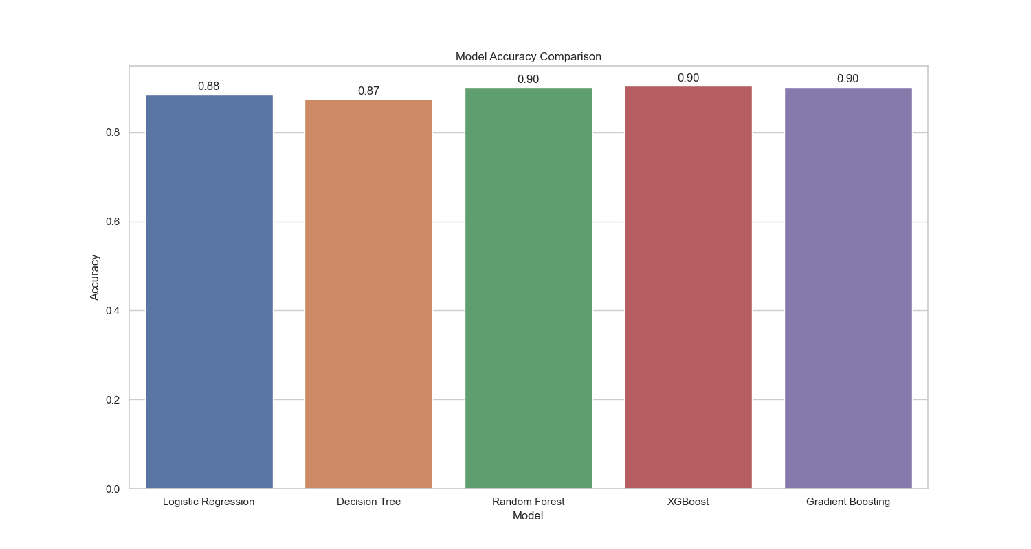
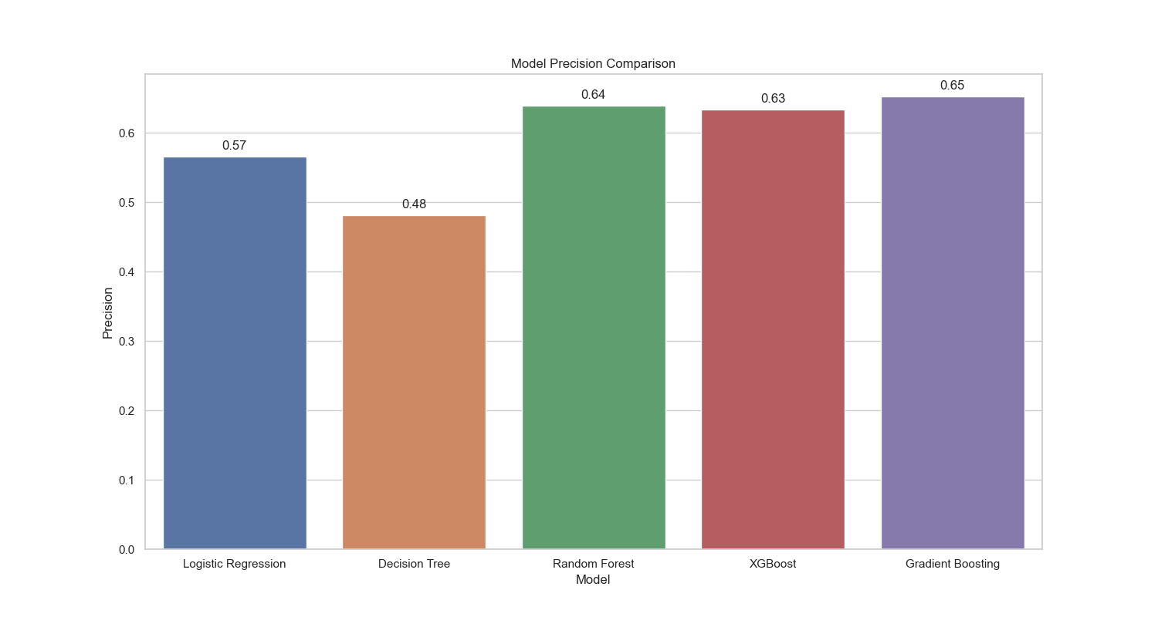
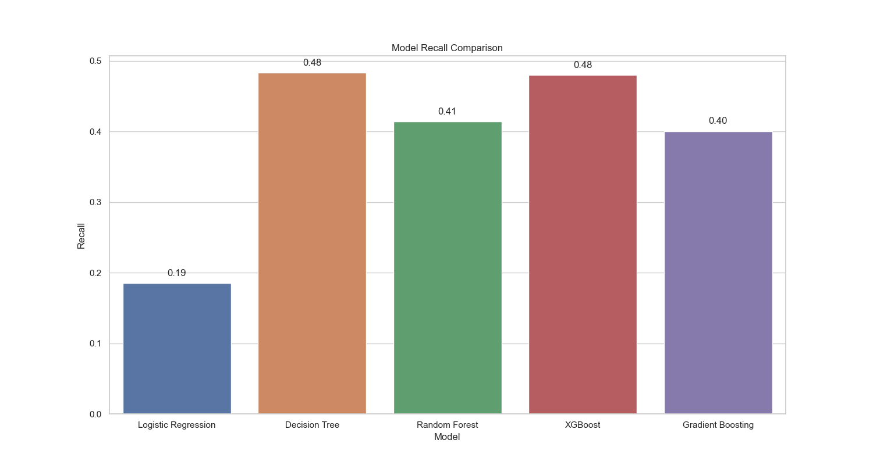
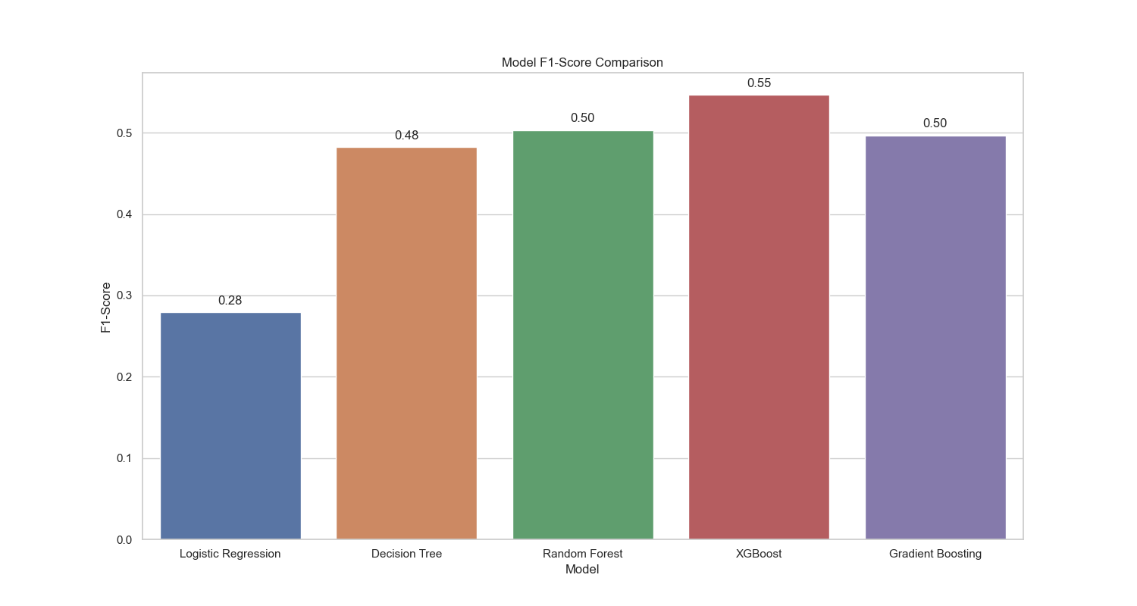
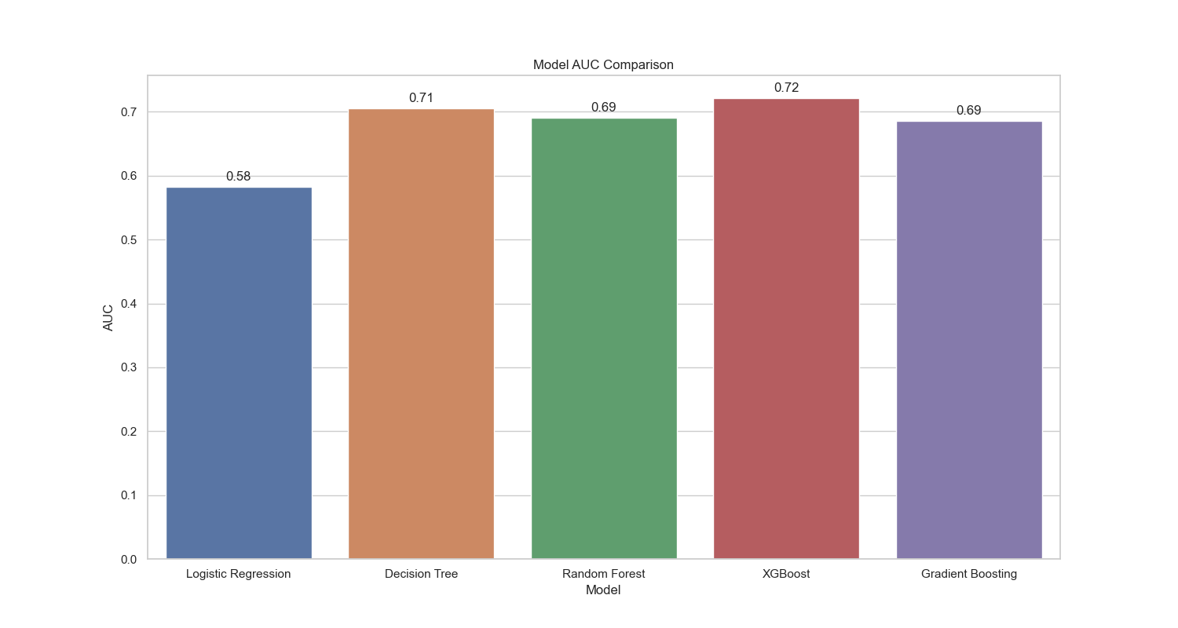
Model Performance Summary

Slide 7
Baseline vs. Advanced Models
Accuracy: Advanced models, including Random Forest, XGBoost, and Gradient Boosting, all achieved an accuracy of 0.90, outperforming the baseline models. Logistic Regression had an accuracy of 0.88, while Decision Tree had 0.87.
AUC: The XGBoost model achieved the highest AUC score of 0.72, followed by Decision Tree with 0.71. Random Forest and Gradient Boosting had AUC scores of 0.69, and Logistic Regression had the lowest at 0.58.
F1-Score: XGBoost achieved the highest F1-Score of 0.55, indicating its superior balance between precision and recall. Random Forest and Gradient Boosting both scored 0.50, while Logistic Regression had the lowest F1-Score of 0.28.
Precision: Gradient Boosting had the highest precision at 0.65, followed by Random Forest with 0.64, and XGBoost with 0.63. Logistic Regression and Decision Tree had lower precision scores of 0.57 and 0.48, respectively.
Recall: The Decision Tree and XGBoost models both had the highest recall at 0.48, indicating their effectiveness in capturing all relevant positive instances. Random Forest had a recall of 0.41, while Gradient Boosting and Logistic Regression had lower recall values of 0.40 and 0.19, respectively.
The comparison clearly shows that the advanced models (Random Forest, XGBoost, and Gradient Boosting) outperform the baseline models (Logistic Regression and Decision Tree) across multiple metrics, indicating their suitability for optimizing bank marketing strategies.

Slide 8
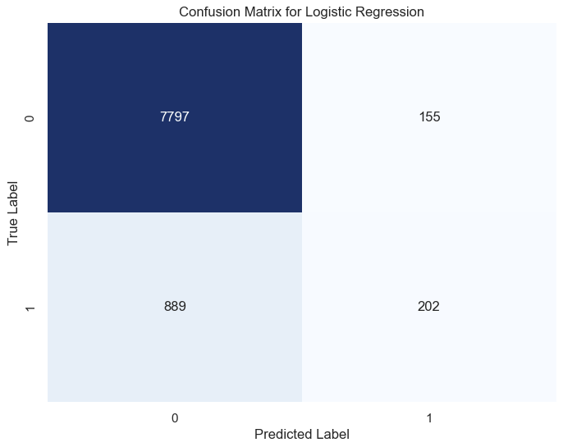
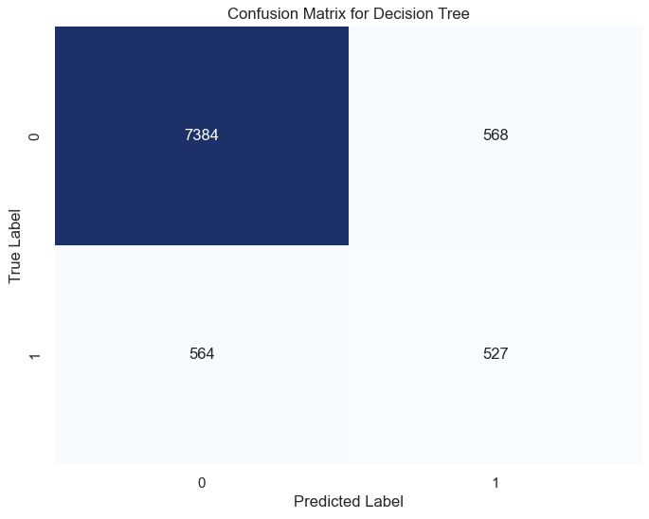
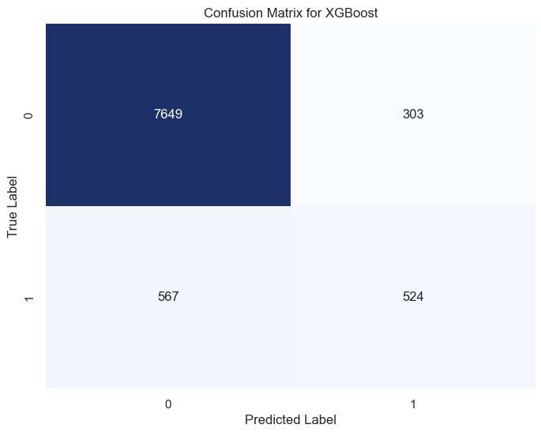


Confusion Matrix for Model Performance

Slide 9
Confusion Matrix Analysis
The confusion matrix provides a detailed breakdown of True Positives (TP), False Positives (FP), True Negatives (TN), and False Negatives (FN).
Logistic Regression: Achieved 7797 TN but only 202 TP, with 889 FN, showing weaker performance in capturing true subscribers.
Decision Tree: Predicted 7384 TN and 527 TP, with 568 FP, reflecting moderate performance in identifying positive cases.
Gradient Boosting: Correctly predicted 7719 non-subscribers (TN) and 437 subscribers (TP) but also had 654 false negatives.
Random Forest: Correctly predicted 7697 TN and 452 TP, with 639 FN, indicating balanced but not outstanding performance.
XGBoost: Achieved 7649 TN and 524 TP, with a relatively low number of 567 FN, showing overall strong performance.
The confusion matrix analysis highlights the models' abilities to distinguish between the two classes effectively, with XGBoost and Gradient Boosting showing a good balance between true and false predictions. The false negative rate is a critical aspect, especially for identifying potential customers who could be targeted for better marketing outcomes.

Slide 10
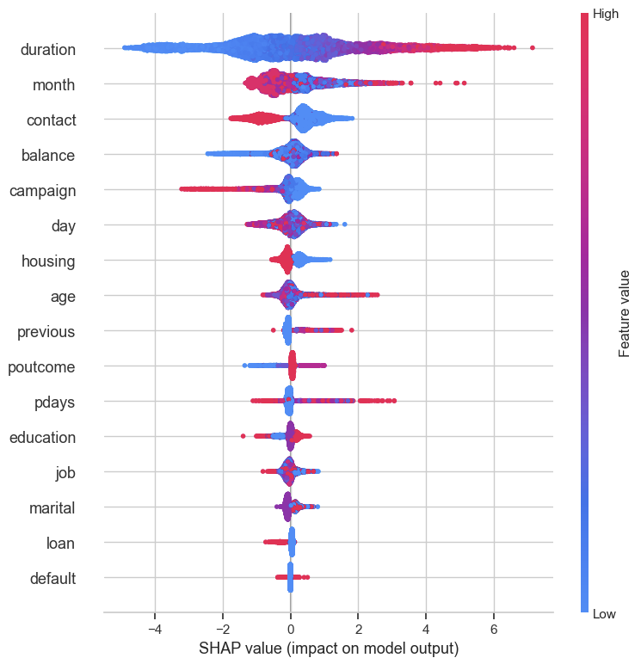
SHAP values for feature importance in XGBoost
XGBoost SHAP Analysis: The SHAP values indicate that duration was the most influential feature in predicting term deposit subscription, followed by month, contact type, and balance.
High values of duration contributed significantly to positive outcomes, showing that longer calls are correlated with successful conversions.
Features such as campaign and housing also played notable roles, suggesting specific customer characteristics are crucial in determining outcomes.

Slide 11
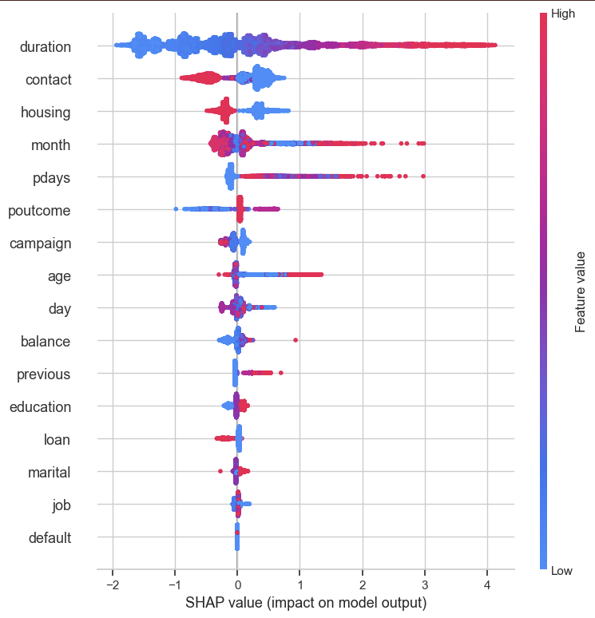
SHAP values for feature importance in GRADIENT BOOSTING
Gradient Boosting SHAP Analysis: Similar to XGBoost, duration was the top contributor, but contact type and housing also had considerable impacts.
Interestingly, pdays (number of days since last contact) showed higher importance in Gradient Boosting compared to XGBoost, indicating its significance in this model.
This suggests that recent customer interactions might be more relevant in the Gradient Boosting model's predictions.
The SHAP analysis helps identify actionable insights, such as focusing on increasing call duration and targeting customers who were recently contacted or have specific financial characteristics.

Slide 12
Limitations of the project
Model Performance: While some predictive models showed very good performance, some showed poor performance due to overfitting, which, therefore, contributes to the limits of generalizability due to a bias toward the training construct.
Data Imbalance: The dataset was encountered with class imbalance issues, which hindered most of the developed models with worse recall for minority classes.
Limited Features: The feature set used in operating the model was very limited; some additional significant features, incorporated into the existing set of variables, could improve model performance.
Assumptions Made: While engendering features, some assumptions like treating missing values as a zero were made and might have affected the accuracy of models.
Computational Resources: Due to insufficient computational resources, the hyperparameter tuning could not be exhaustive, potentially making some effects in model optimization.
Interpretability: Some of the models remain poorly interpretable; for example, Gradient Boosting and XGBoost-I have hard interpretive means - undermined therefore the provision of actionable insights.

Slide 13
Conclusion
Best Performing Model: Of all models tested, XGBoost overtook and won the title of the best performer in customer conversion prediction, with the highest AUC across metrics of precision, recall, and F1-score.
Key Features for Conversion: The analysis revealed that features such as duration of the last contact, contact type, and previous campaign performance significantly contribute to building effective predictive models. Marketing managers now have insights on where to focus their efforts, i.e., in the right direction.
Actionable Insights: SHAP analysis provided stakeholders with interpretable insights about model behavior, indicating that higher call duration and targeting specific customers (e.g., those without housing loans) could be effective strategies to increase conversion rates.

Slide 14
DISCUSSION
Campaign Strategy: The marketing plan will utilize insights from this model in targeting specific customer segments that have previously shown higher probabilities of conversion, thus enhancing marketing efficiency and lowering costs.
Model Improvements: The addition of new features that were not in the original dataset may improve model accuracy further. Ones to consider include customer satisfaction ratings, geography, and transaction behavior.
Mitigation of Limitations: Techniques such as SMOTE could alleviate data imbalance and therefore assist with improving minority class recall, but that would particularly be beneficial for those customer segments that are underrepresented. Furthermore, more time should be dedicated to tuning hyperparameters on better computational resources to allow for overall model optimization.
Real Life Application: The developed models could by integrated within the bank's CRM system for real-time scoring on marketing campaigns, allowing for more dynamic adjustment of campaign targets based on customer probabilities of conversion.

